Slide 1

Prompt Engineering
Prompt engineering is the art and science of crafting effective instructions for large language models (LLMs). By carefully designing prompts, we can guide these models to generate desired outputs, such as summarizing text, translating languages, or generating code.
Pavan Sesha Sai Kasukurti
GitHub: kpavan3009

Slide 2
What do we Cover
Large Language Models (LLMs) and Prompting
What is a Prompt
Why is Prompt Engineering Important
Applications of Prompt Engineering
Basic Prompt Engineering Techniques
Advanced Prompt Engineering Techniques
Challenges and Limitations of Prompt Engineering

Slide 3

Large Language Models (LLMs) and Prompting
LLMs are powerful AI models trained on massive datasets of text and code.
1
Training
LLMs learn patterns and relationships in data, enabling them to generate coherent and informative outputs.
2
Prompting
We use prompts to provide instructions and context for the LLM to process and generate outputs.
3
Applications
LLMs, with proper prompting, power various applications, from text summarization to code generation.

Slide 4

What is a Prompt?
A prompt is an input given to an LLM to elicit a specific response.
1
Instructions
2
Context
Prompts can be simple instructions, like "Summarize this article."
They can also provide context, such as "Translate this text into Spanish."
3
Examples
Prompts can even include examples of desired outputs to guide the model.

Slide 5
Why is Prompt Engineering Important?
Prompt engineering is crucial for maximizing the potential of LLMs.
Accuracy
Efficiency
Control
Well-crafted prompts lead to more accurate and relevant outputs, reducing hallucinations.
Effective prompts enhance efficiency by guiding the model toward desired results, minimizing unnecessary iterations.
Prompt engineering gives us greater control over the model's behavior, enabling us to tailor outputs to specific needs.

Slide 6

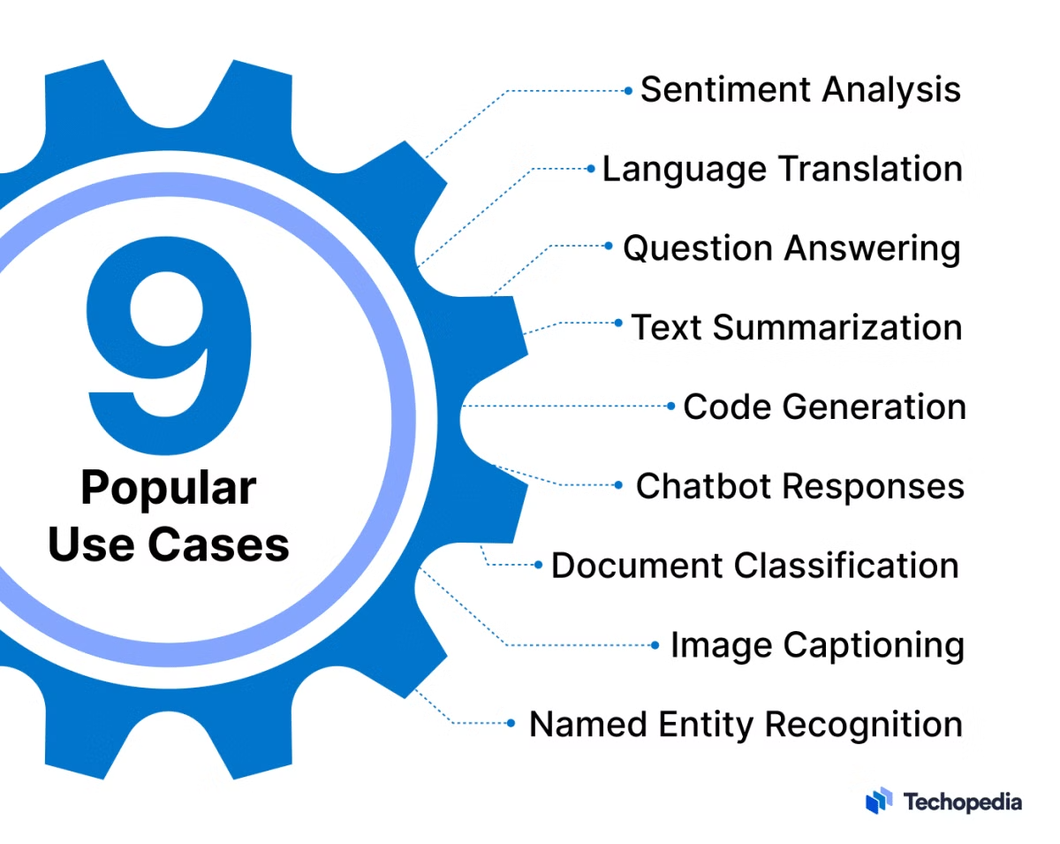
Applications of Prompt Engineering
Prompt engineering unlocks the potential of LLMs across various domains.
Summarization
Translation
Generate concise summaries of lengthy articles, reports, or documents.
Translate text between different languages, ensuring accuracy and fluency.
Sentiment Analysis
Code Generation
Analyze text to identify the overall sentiment, such as positive, negative, or neutral.
Generate code in various programming languages, from simple scripts to complex applications.

Slide 7

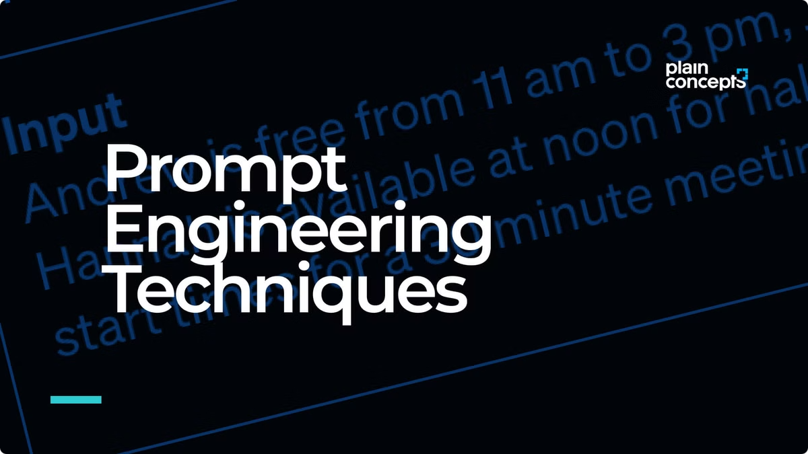




Basic Prompt Engineering Techniques
Several fundamental techniques can significantly enhance prompt effectiveness.
Use Delimiters
Ask for Structured Output
Clearly separate different parts of the prompt using symbols or keywords.
Specify the desired output format, such as a list, table, or JSON object.
Check Conditions
Few-Shot Prompting
Verify if the model's response meets specific criteria or constraints.
Provide a few examples of desired outputs to guide the model's behavior.

Slide 8

Advanced Prompt Engineering Techniques
Advanced prompt engineering techniques push the boundaries of LLM capabilities.
Chain-of-Thought
Guide the LLM to reason through a problem step by step, improving accuracy and explainability.
Reflexive Prompting
Enable the LLM to evaluate its own output and make corrections or improvements.

Slide 9

Challenges and Limitations of Prompt Engineering
Prompt engineering faces several challenges and limitations.
1
Ambiguity
2
Bias
LLMs can interpret prompts differently, leading to inconsistent or unexpected outputs.
LLMs can reflect biases present in the data they are trained on, potentially leading to unfair or discriminatory outputs.
3
Hallucination
LLMs can sometimes generate factually incorrect or nonsensical outputs, especially in complex scenarios.

Slide 10
THANK YOU
The key to an effective prompt engineer isn’t so much about knowing the better prompt, it is about having the good process to develop a better prompt for an application.

